Slide 1
OPTIMIZATION
(OR: is that the best you can do?)
Very often in life we are faced with a situation wherein we have to decide what is the best course of action within a certain set of conditions.
For example, consider the following situation:
A little doggie is near the shore of a lake. Near the shore (all distances are known) there is also a tree. The doggie is thirsty, consequently it plans to get a drink, but then will go visit the tree.

Slide 2
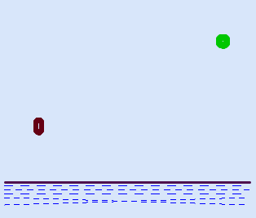
Here is a picture of the situation:
Doggie wants to do all of his business walking as little as possible. Can you help him?

Slide 3
This is a classical OPTIMIZATION problem.
A certain quantity (the distance traveled) is to be optimized (in this case minimized, but in other situations we may want to maximize something, maybe our profit, or our GPA)
The value of the quantity depends on some choice we may make, within certain limits (the doggie has to choose where to get a drink, but definitely not away or past the position of the tree along the shore.) The question asked of the mathematician is
what choice will optimize the quantity in question?

Slide 4
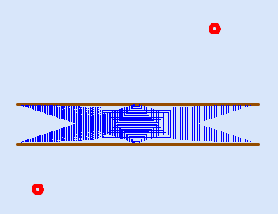
Another, less facetious situation. You live one mile north of a 600 ft wide river. Your significant other lives 0.5 miles south of the river, 1.5 miles west of you. You can swim the river in 25 minutes, and your walking speed is 6 mph. Of course, you want to get to your significant other is=n as little time as possible. What do you do?
The figure might help.

Slide 5


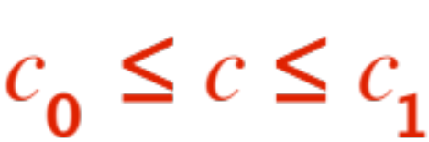
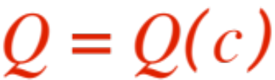
Let’s abstract the situation:
There is a quantity that is to be
Optimized
(don’t forget, that may mean minimized or maximized)
The value of depends on a choice we may make. Of course, there are limits to what choices we can make, that is .
So, here is what we have:
A function is to be minimized or maximized, subject to . Seen this before?

Slide 6
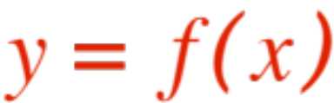
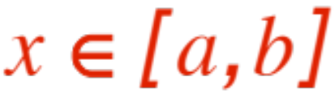



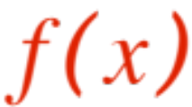
That’s right, it’s our old friend ! …
Find the absolute maximum and minimum of
Piece of cake!
Find the critical points of the first derivative.
Compute the value of at each, plus …
at the end-points and .
The smallest you get is the absolute minimum
The largest is the absolute maximum.
The devil is in the details, finding .

Slide 7

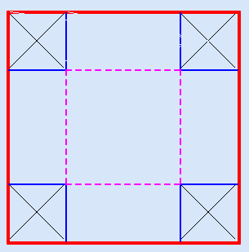
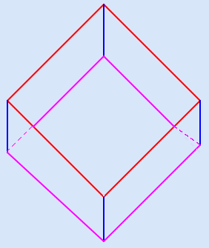

Here is a nice, doable problem, with a little twist at the end.
You are given a piece of cardboard (disregard the thickness). You are going to cut out four little squares at each corner and fold the remaining piece into a coverless box, as shown
We will ask three questions, each a twist on the previous one. Here we go.

Slide 8

Q1. What’s the biggest box you can make?
Q2. Joining the blue (vertical) edges costs $1.00
per linear inch. You have $16.00 you can
spend on this job. What’s the biggest box
you can make?
Q3. Besides the cost of joining the blue (vertical)
edges, there is a cost for folding the violet
edges, also $1.00 per linear inch. They did
double your budget, you now have $32.00 to
spend on this job. What’s the biggest box
you can make?

Slide 9
We end this presentation with a sequence of five steps you should follow to achieve a successful solution to an optimization problem.
Draw a figure. Make it as neat as you can, showing all the relevant components of the problem. (Sometime the figure is drawn for you!)
Identify (in your mind and possibly in the figure) the quantity you are supposed to optimize (the objective quantity), and give it a name (V, A, D, Grandpa, whatever), as well as specifying whether you are seeking to maximize it or minimize it.

Slide 10

Identify (in your mind and possibly in the figure) the quantity you have freedom to choose (the independent quantity), give it a name (you don’t have to choose , it’s a free country!)
Find (here is where the ‘devil is in the details’ takes place !) the formula that expresses the objective quantity (from step 2.) in terms of the independent quantity (from step 3.)
Find what constraints there are on your freedom of choice, i.e. within what bounds the independent quantity can vary.

Slide 11
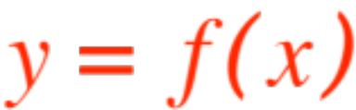


Now you are back on familiar ground. You have a formula ( is the objective quan-tity, the independent one)
and an interval (from step 5. ). Find either the absolute maximum or the absolute minimum (review step 2. ) and you have solved the problem.
Please don’t forget to answer it! You may have been asked the value of or of , or a related number. E.g., in the “you, your loved one and the river”, you may be told:
you leave your house at 2:45 pm, what time do you see your loved one? (that’s neither nor )

